Slide 1
Convolution-Free Medical Image Segmentation using Transformers
Ajou Univ. software dep. 201920723 김동욱
Kim Dong Wook

Slide 2
Transformer ?
RNN with attention(seq2seq with attention)
This is SLOW
Start
Score 1
Score 2
Score 3
Context
vector
Output 1
Output 2
Output 3
Input 1
Input 2
Input 3

Slide 3
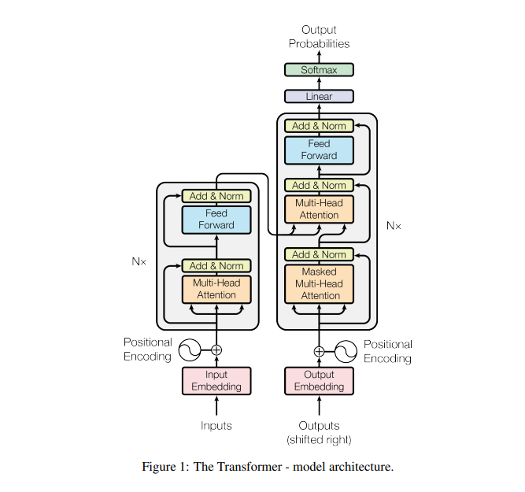
Transformer?
NO RNN, only attention
Use positional encoding

Slide 4
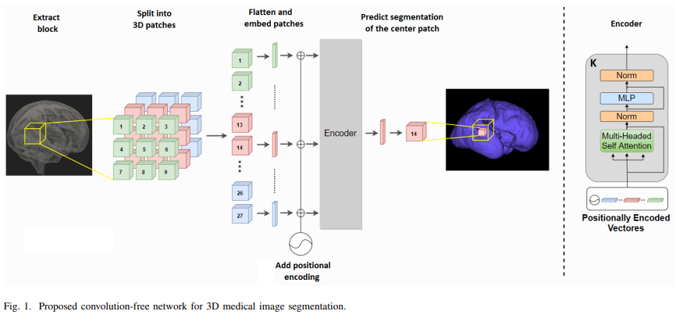
model

Slide 5
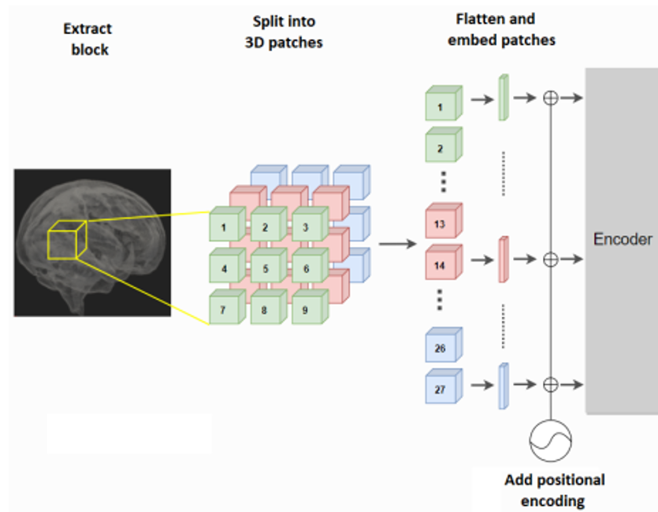
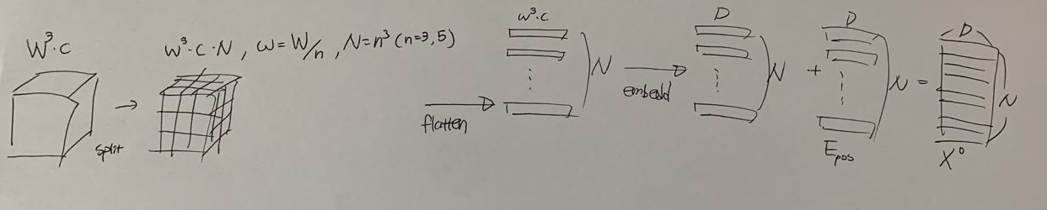
model

Slide 6
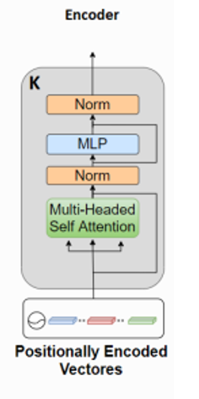
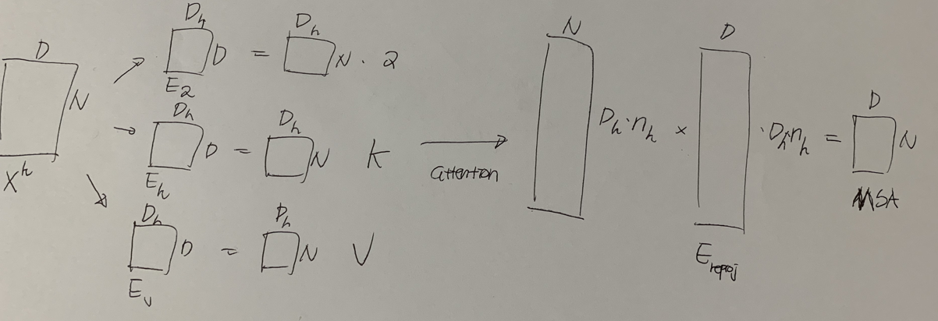
model

Slide 7
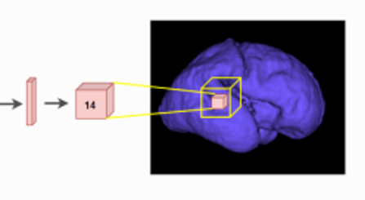

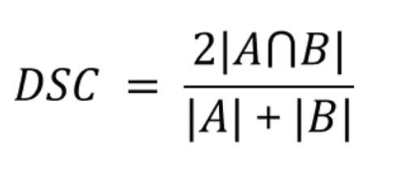
model, loss
Maximize dice similarity coefficient between Y and ground truth

Slide 8
train
Pre-train with unlabeled data for denoising or inpainting tasks
Used L2 Norm when pre-train
Fine tune with DSC

Slide 9
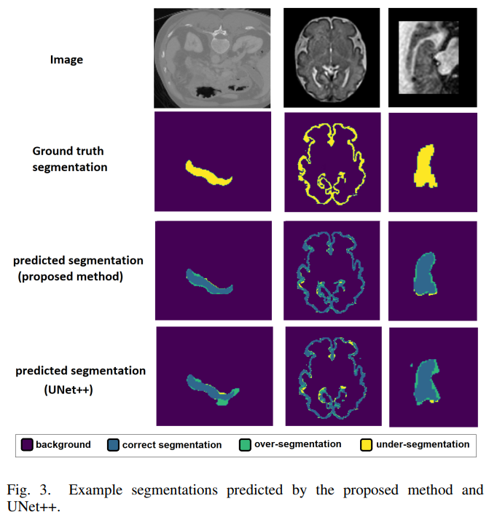
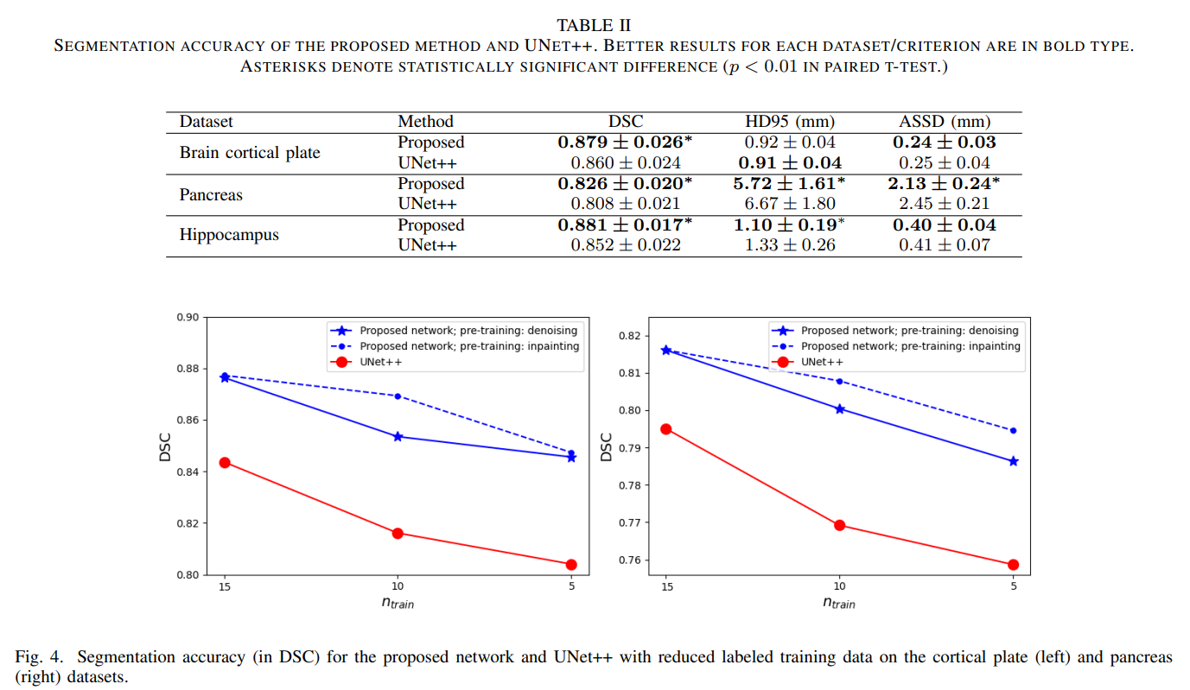
result

Slide 10
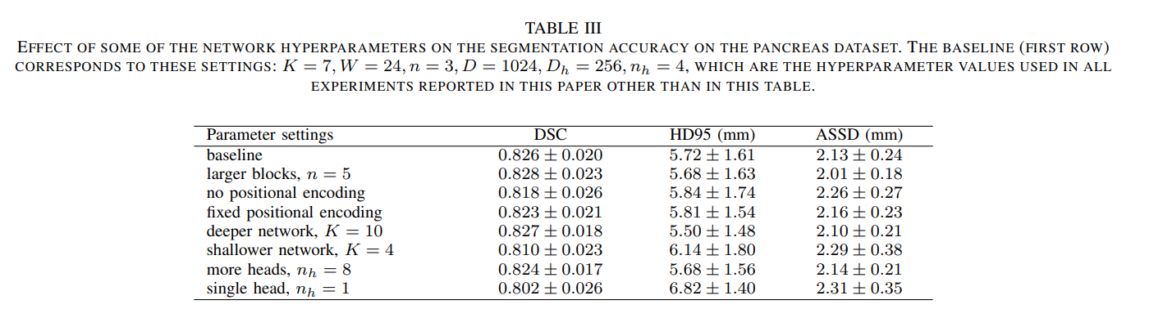
result

Slide 11
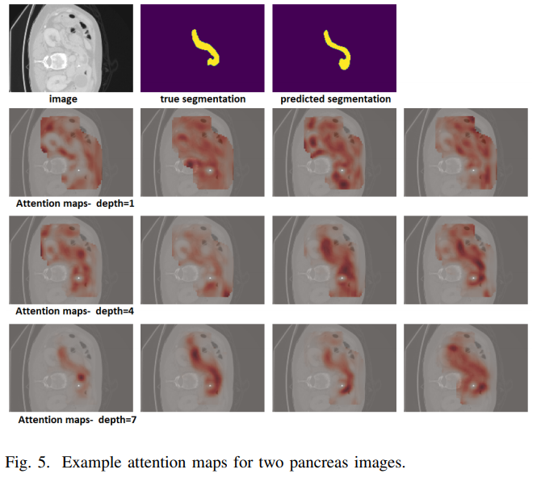
result

Slide 12
result
Better than sota(Unet++)
Very good performance with a fewer labeled data
No Convolution
Attention used

